Slide 1
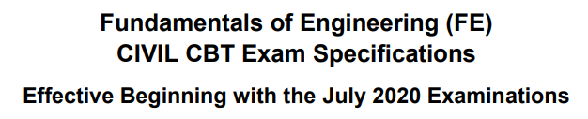
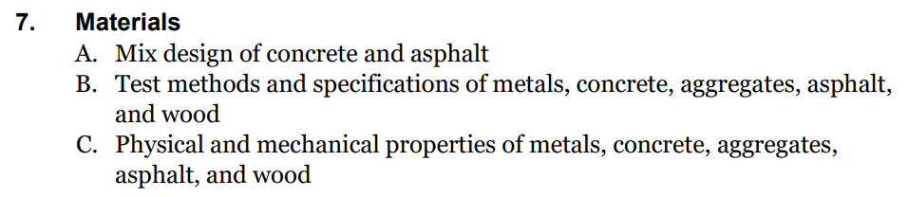

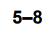
FE Exam Civil CBT Specifications Section 7 - Materials

Slide 2
Review on Civil Engineering Materials
Aggregates
Portland Cement Concrete
Asphalt Concrete
Steel
Wood

Slide 3
Aggregates

Slide 4
Classification of Aggregates
Based on Origin (Natural & Artificial)
Based on Density of Particles
Normal Weight (SG 2.5-2.8); Light Weight (SG 1.5-2.0)
Based on Method of Processing
Based on Affinity to Water
Hydrophilic (siliceous); Hydrophobic (Carbonaceous)
Based on Particle Size
Coarse Aggregate (Larger than #4 sieve)
Fine Aggregate: #4(4.75mm) to #200 sieves (75 μm)
Mineral filler (finer than #200 sieve)
Crushed
Uncrushed

Slide 5
Natural & Artificial Aggregate Types
Natural aggregates from:
Igneous Rocks (Granite, Basalt)
Metamorphic Rocks (Marble, Gneiss, Quartzite)
Sedimentary Rocks (Limestone, Dolomite, Sandstone, Caliche)
Artificial aggregates from:
Byproducts of Industrial Processes (Blast-furnace slag; Iron-ore gravel)
Manufactured Aggregates (Lightweight aggregate, Hydrated fly ash)

Slide 6
Important Aggregate Properties
Gradation (ASTM C-33)
Specific Gravity & Absorption (ASTM C-127, C-128)
Durability
Physical Durability
Abrasion Resistance (LA Abrasion Test: ASTM C131)
Frost Resistance (Soundness Test: ASTM C88)
Chemical Durability
Alkali-aggregate reactivity (in Portland CC)
Shape and Surface Texture
Deleterious Substances (ASTM C-40, C-142)
Standard Tests by ASTM, AASHTO, State DOTs

Slide 7
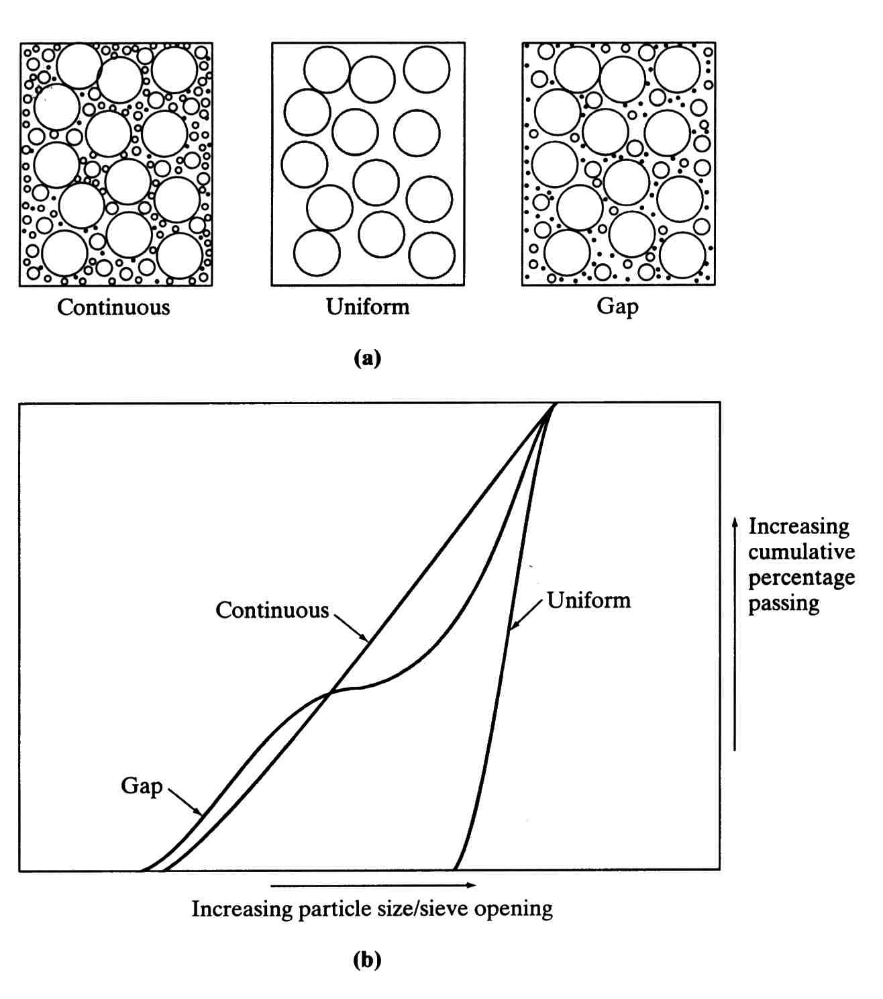
Aggregate Gradations
Continuous
Uniform
Gap

Slide 8
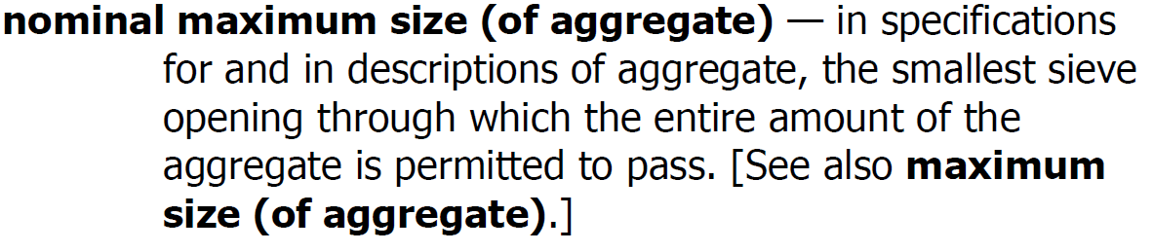
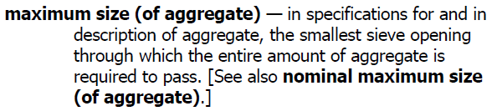

Slide 9
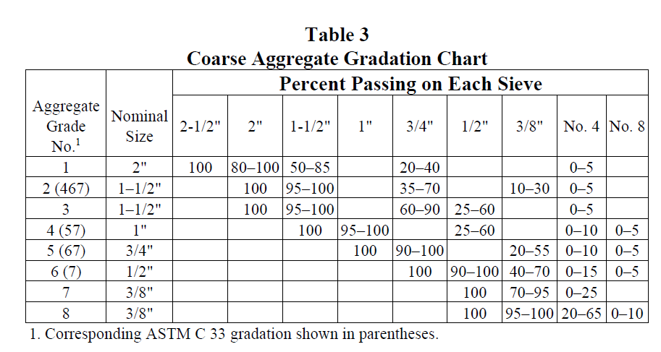

Slide 10
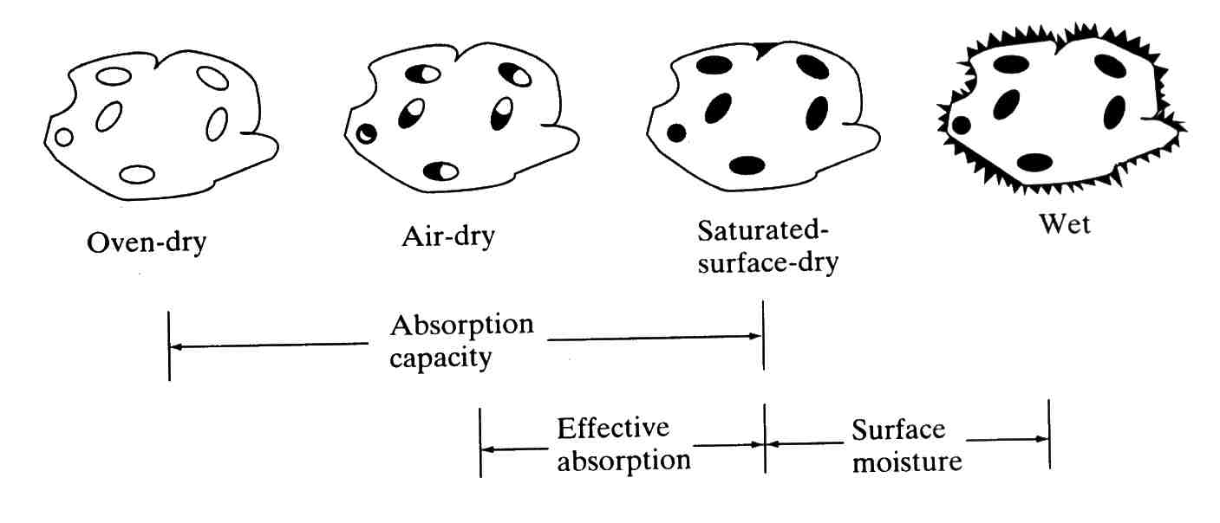
Aggregate Moisture States

Slide 11
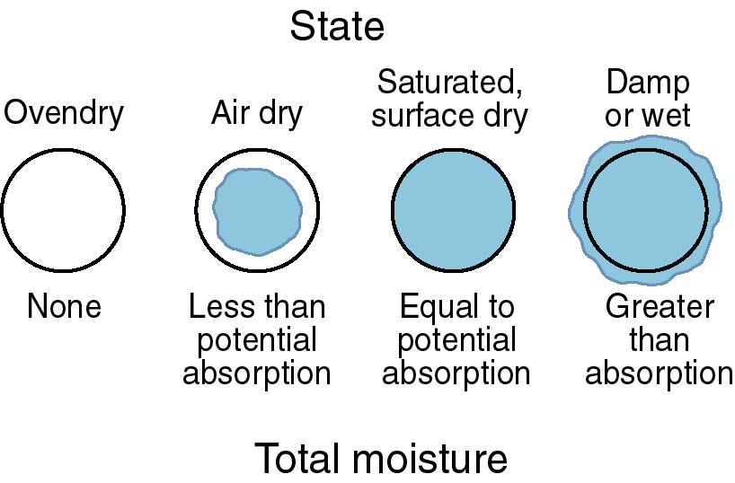
Absorption & Surface Moisture
PCA

Slide 12
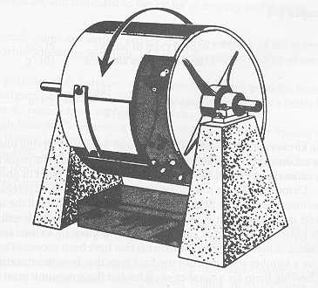
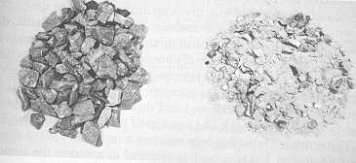
LA Abrasion Test
Soundness Test
Five cycles of
Soaking (in Mg or Sodium Sulfate solution),
Oven Drying
Before
After
(Uses #12 Sieve)
After
(Uses 8mm Sieve)
Before

Slide 13
Portland Cement Concrete

Slide 14
Constituents of Portland Cement Concrete
Cementitious Materials
Portland cement
Mineral admixtures or supplemental cementitious materials (i.e. fly ash, slag, silica fume)
Water
For hydration
For Workability
Aggregates
Coarse aggregate
Fine aggregate
Air Voids
Chemical admixtures

Slide 15
Constituents of Portland Cement Concrete
Portland Cement Concrete (PCC)
Coarse Aggregate
Mortar
Cement Paste
Fine Aggregate (Sand)
Cementitious Materials
Water
Air
Chemical Admixtures
Portland Cement
Supplementary
Cementitious Materials,
aka Mineral Admixtures
(fly ash, slag, silica fume)
Superplasticizers (High-Range Water Reducers) or Water-Reducing Admixtures
Air-Entraining Admixtures
Set-Retarding Admixtures
Set-Accelerating Admixtures

Slide 16
Concrete Construction Issues
Mix Design
Proportioning
Admixtures
Mixing
Batch plant, Mobile mixing plant
Placing
Conveyor, Pump, Bucket, Slip-form
Compaction
Method of vibration, Self-consolidating
Curing
Membrane curing, Wet-mat curing; Steam curing (in mass-production environments)

Slide 17
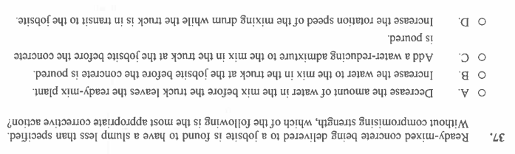

Slide 18
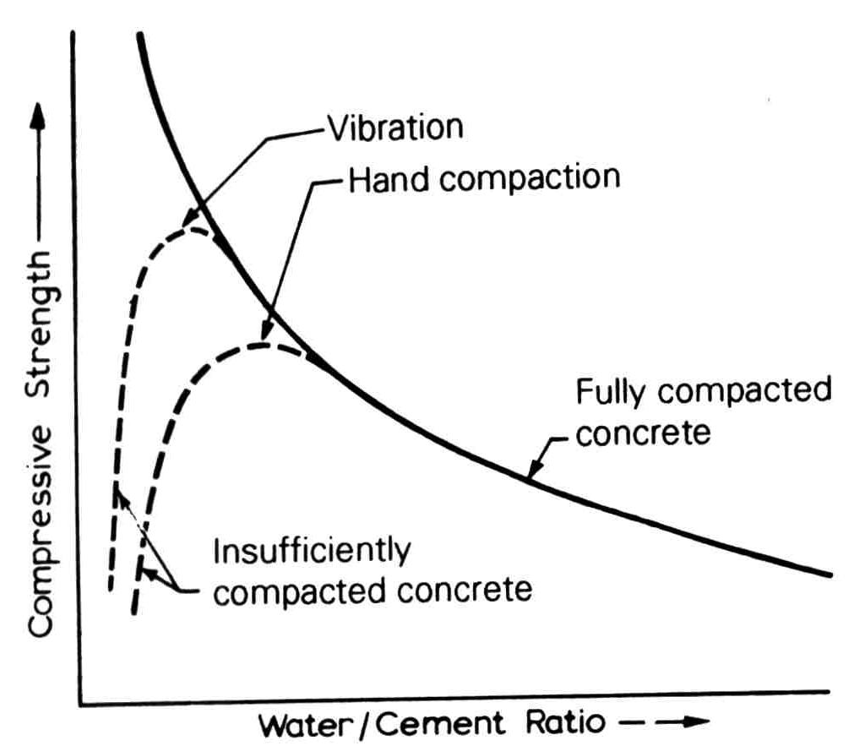
Notes on Concrete Mix Design
Water/cementitious ratio governs strength (0.4~0.5)
Water-reducing admixtures help keep water-cementitious ratio down.

Slide 19
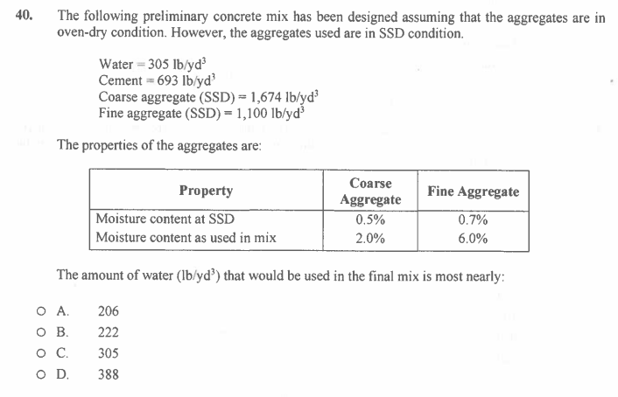

Slide 20
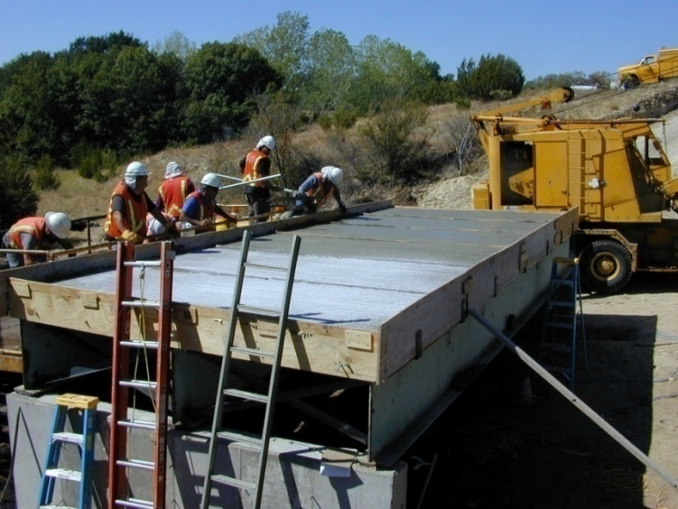
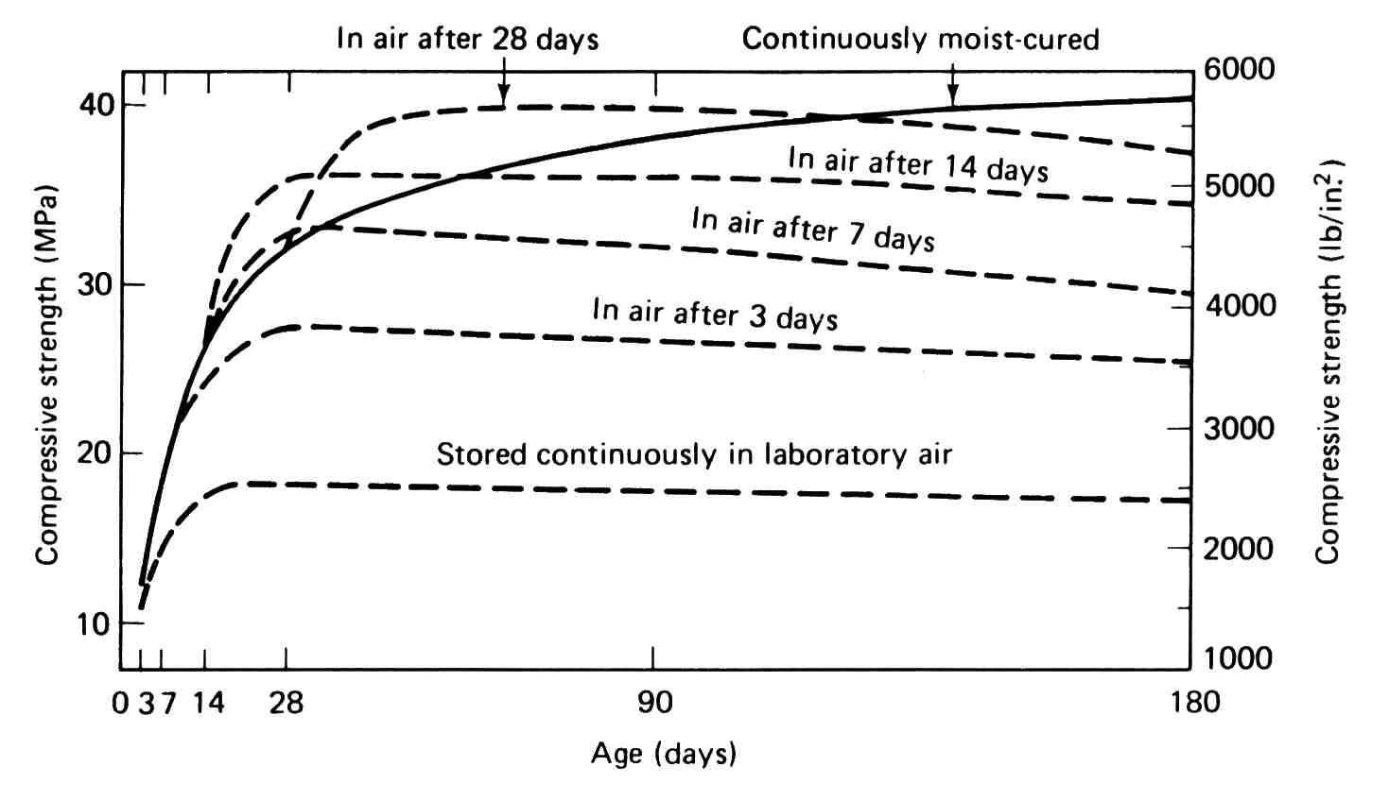
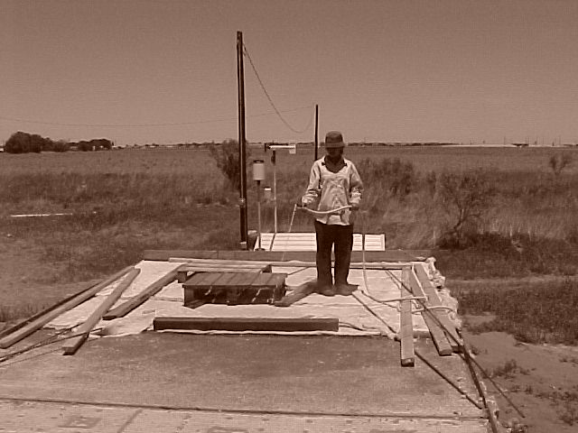
Concrete Curing
Application of Curing
Compound
Moist-Curing using Wet Cotton Mats

Slide 21
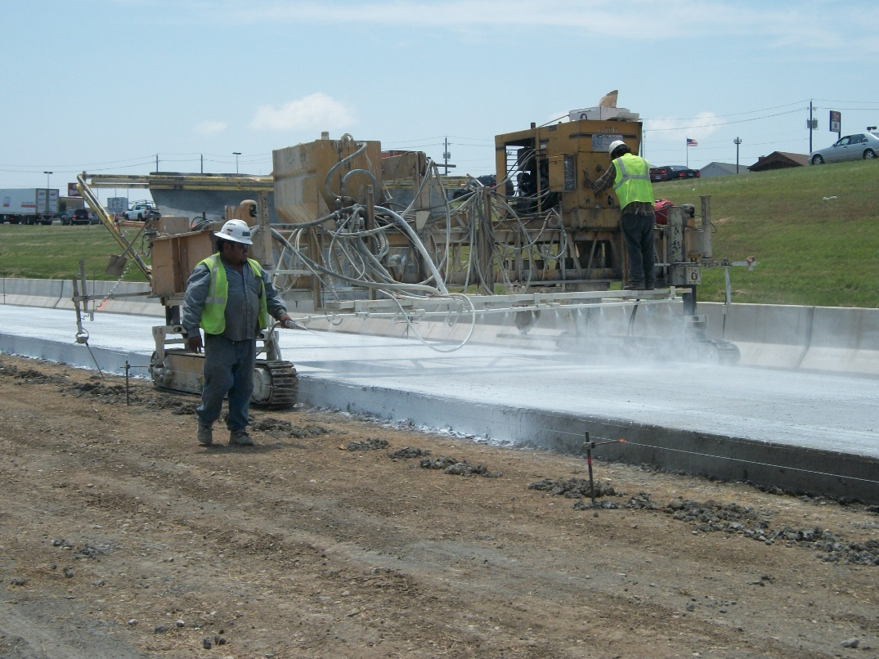
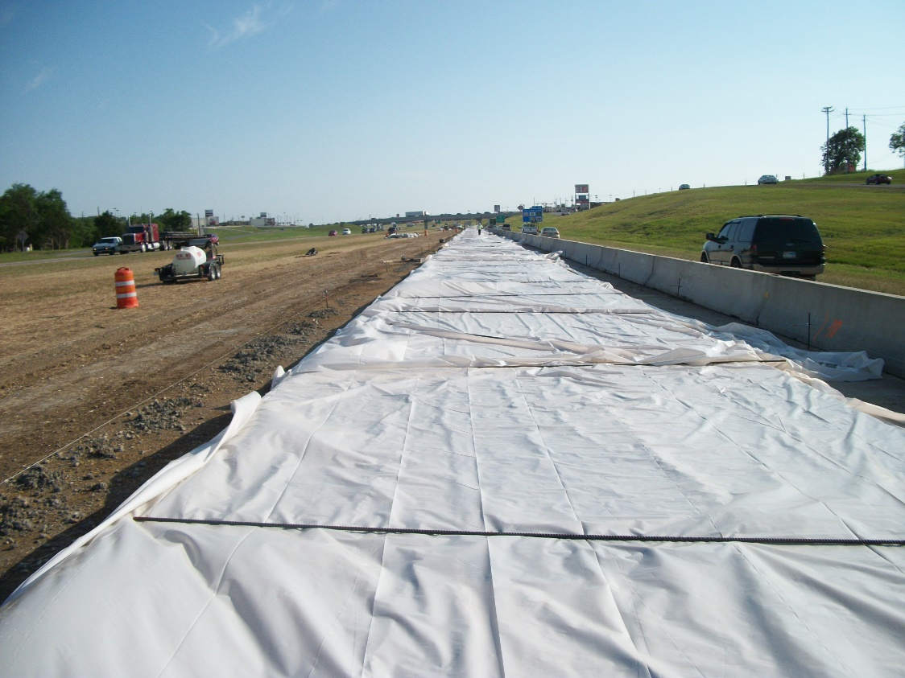

Slide 22
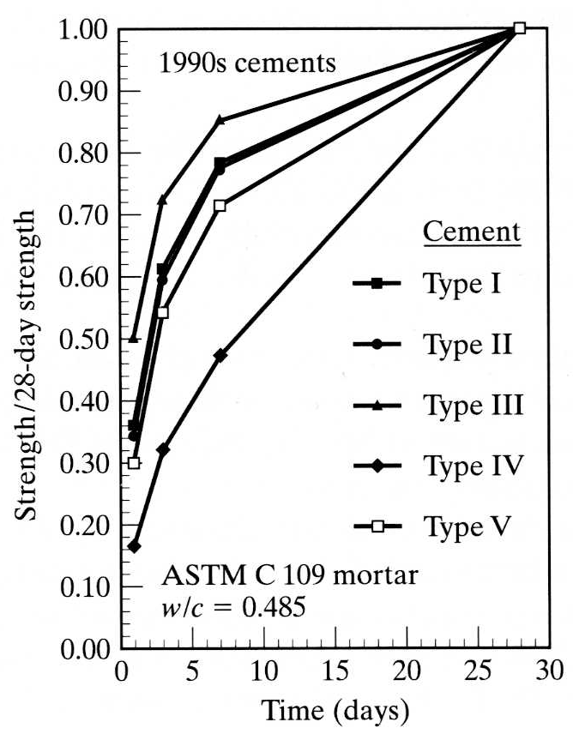
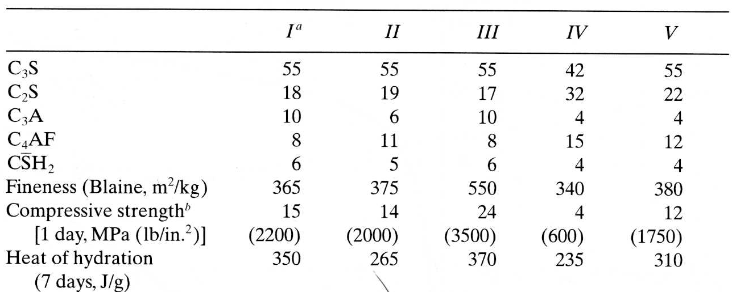
Portland Cement
I Normal (Ordinary)
II Moderate sulfate resistance
III High early strength
IV Low heat of hydration
V High sulfate resistance

Slide 23
Measuring Penetration Resistance
Force Required
Penetrate 1 inch
in 10 seconds
Contact Area

Slide 24
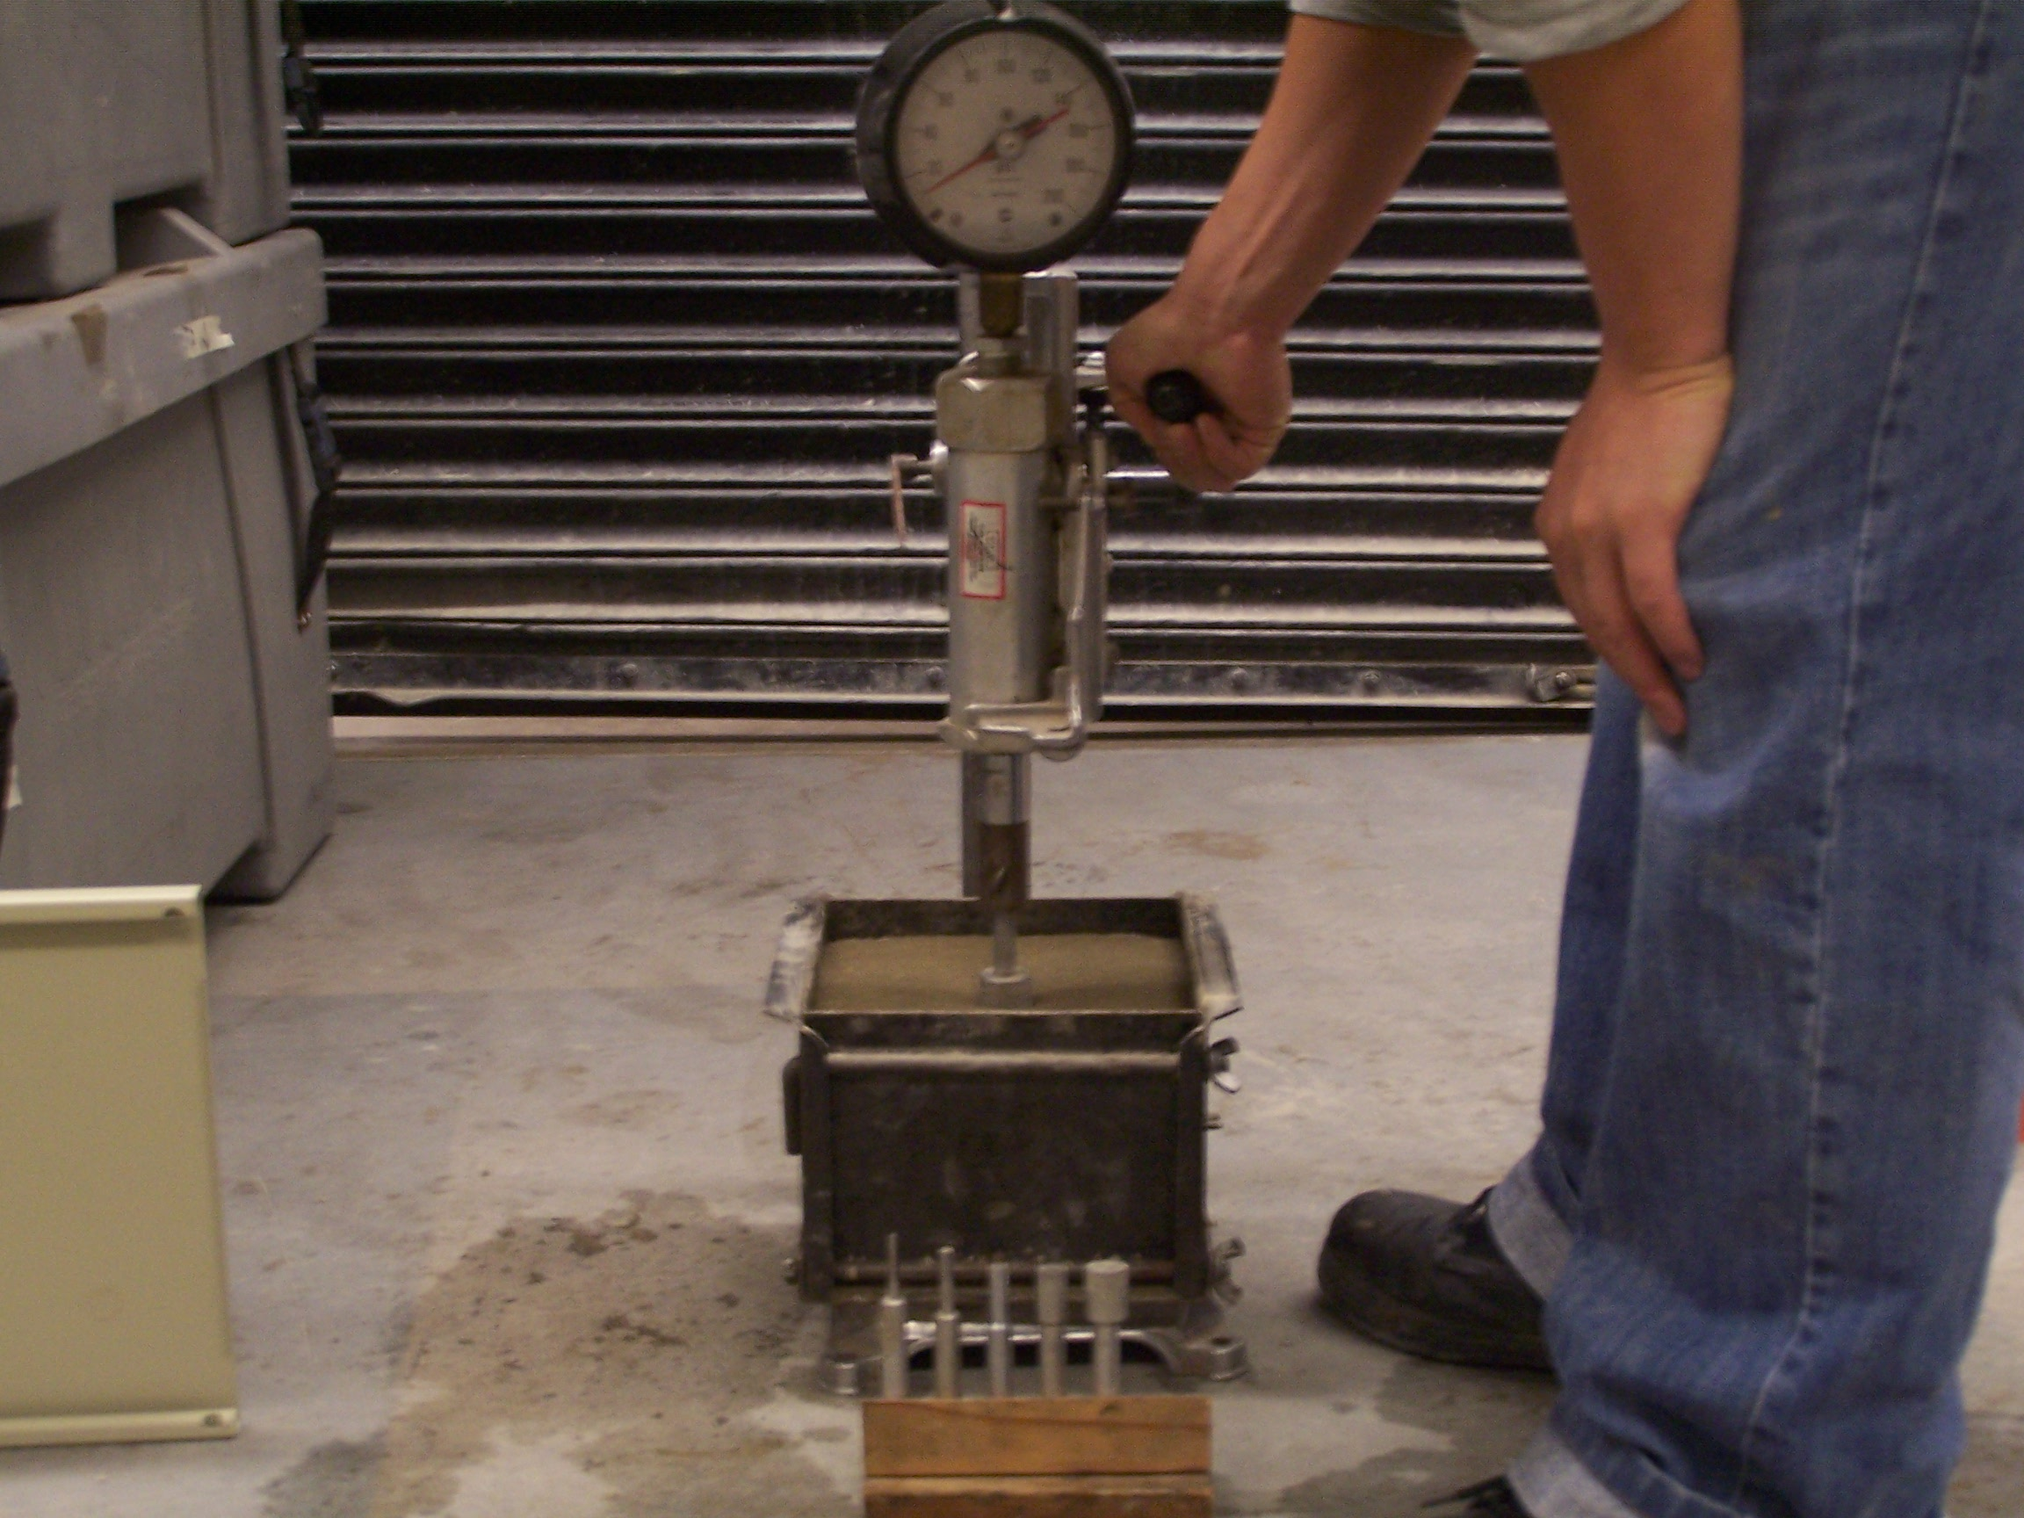

Slide 25
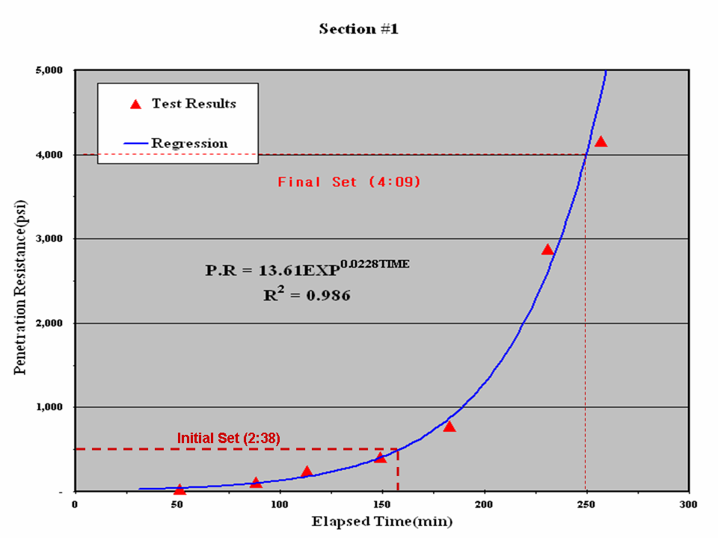
Setting Characteristics of Class P Concrete

Slide 26
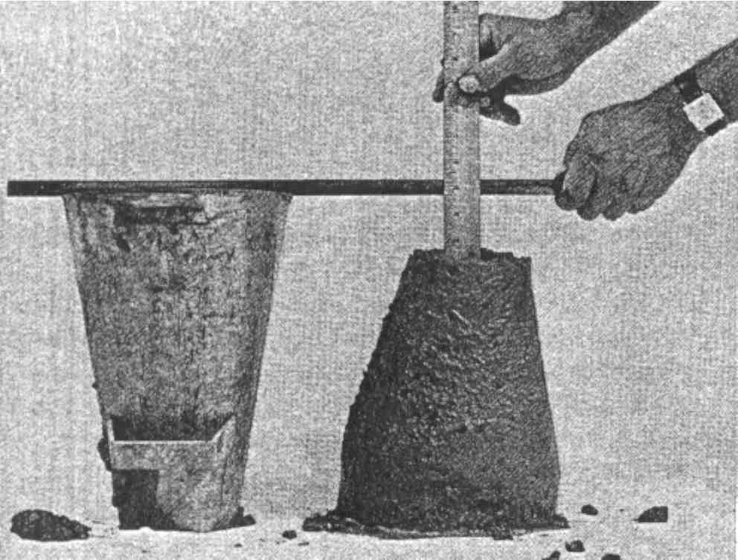
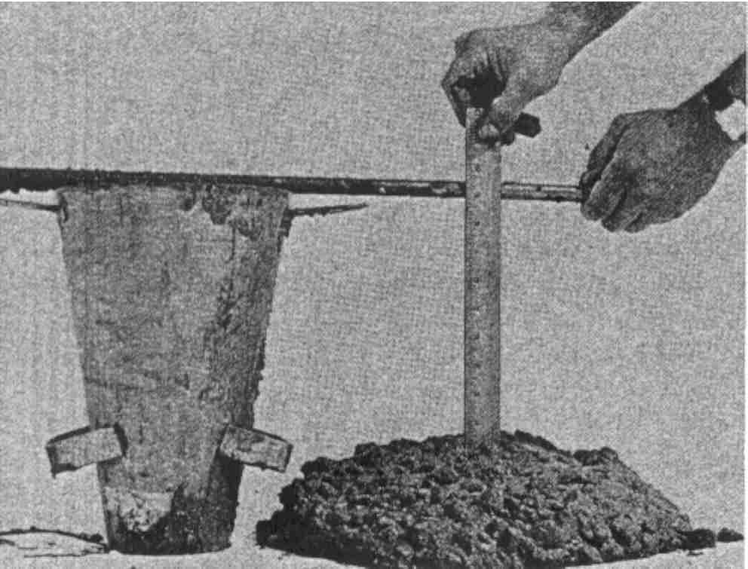
Testing of Fresh Concrete: Slump Test
Low Slump (Low Workability)
High Slump (High Workability)

Slide 27
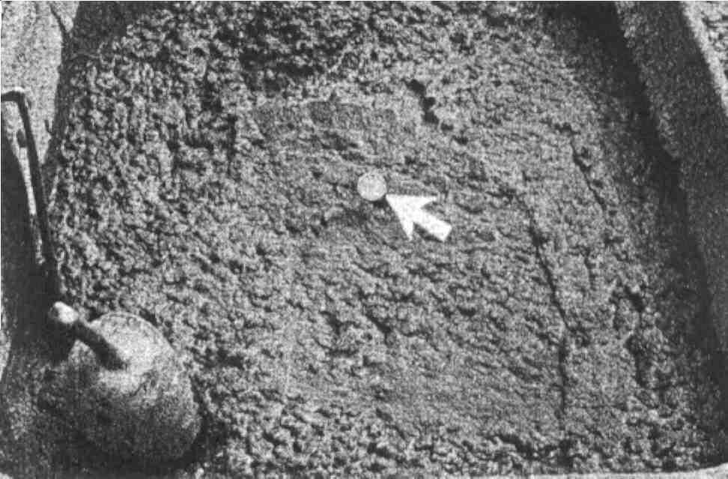
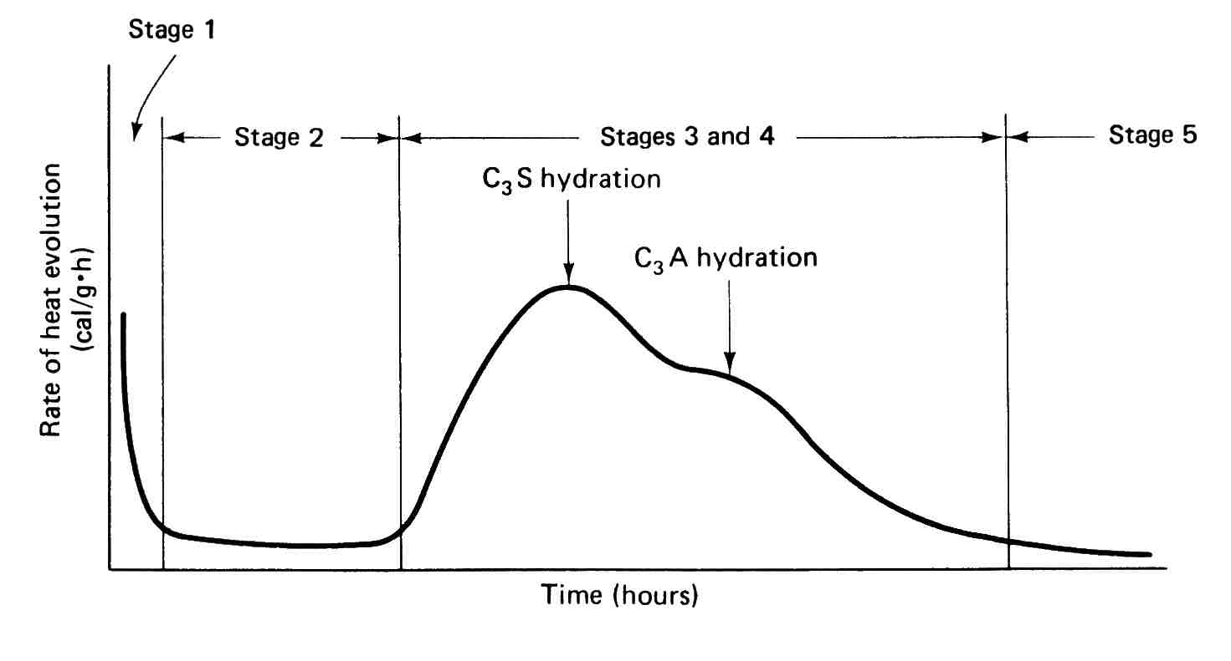
Testing of Fresh Concrete Concrete Temperature

Slide 28
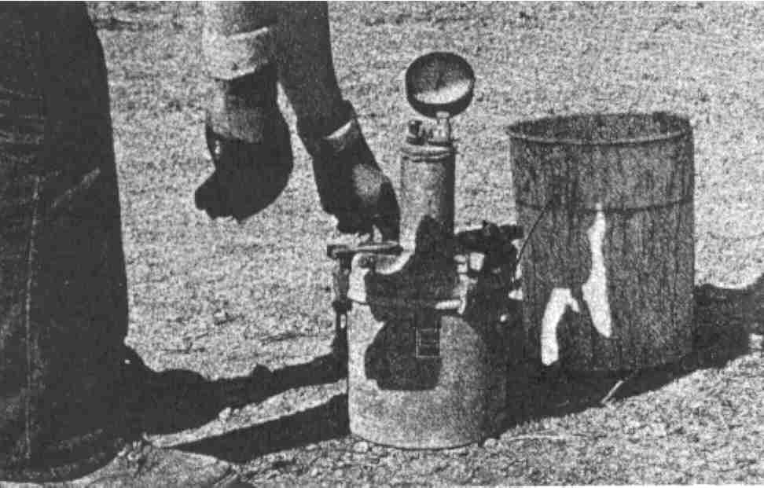
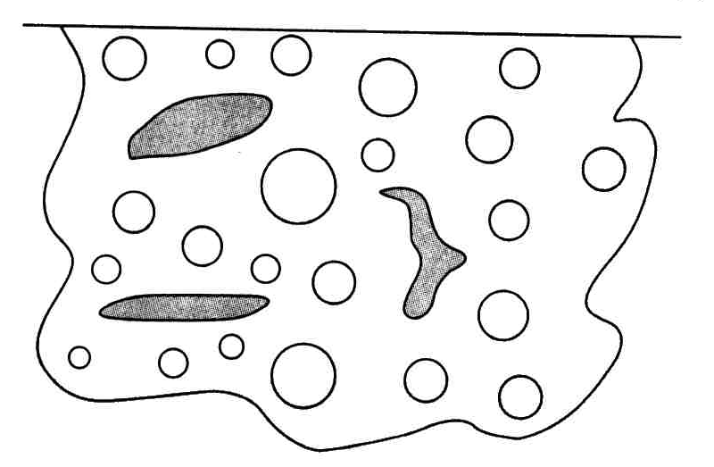
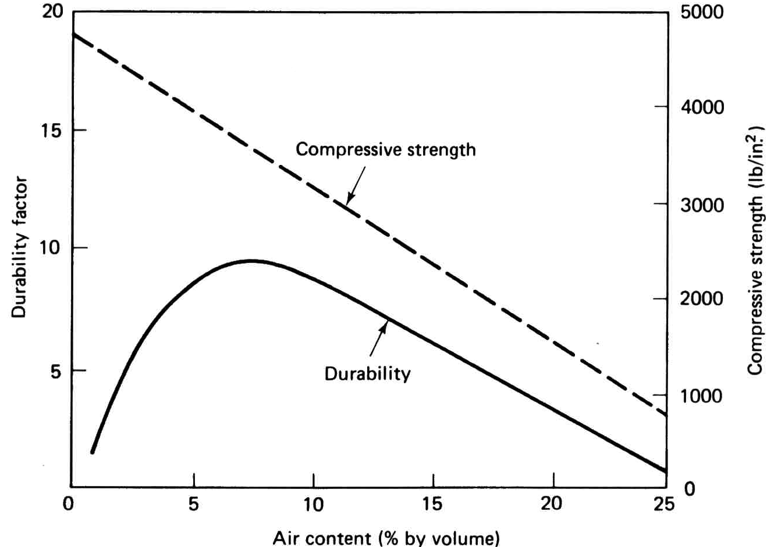
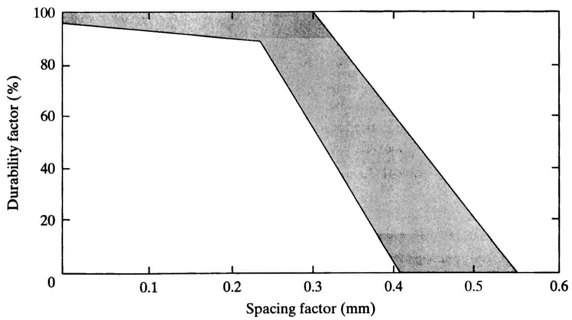
Testing of Fresh Concrete: Air Content
Volumetric Method
Pressure Method

Slide 29
Approximately 0.01 in

Slide 30
Notes:
The thickness of the protected paste shell is the same for the large and small voids. The total protection is much greater for the smaller voids. We conclude that smaller voids are more efficient at providing frost protection. It is important to recognize, however, that all voids offer frost protection, regardless of size. It is just that the smaller one are more effective relative to their volume. When we have our choice we prefer smaller voids over larger voids. When counting up what we have, however, such as in microscopic analysis of hardened concrete, it is important to include all air voids regardless of size, shape, or origin. (See overhead transparency demo of air void effectiveness.)

Slide 31
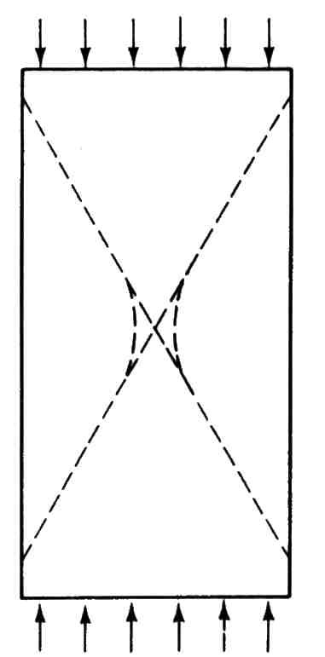
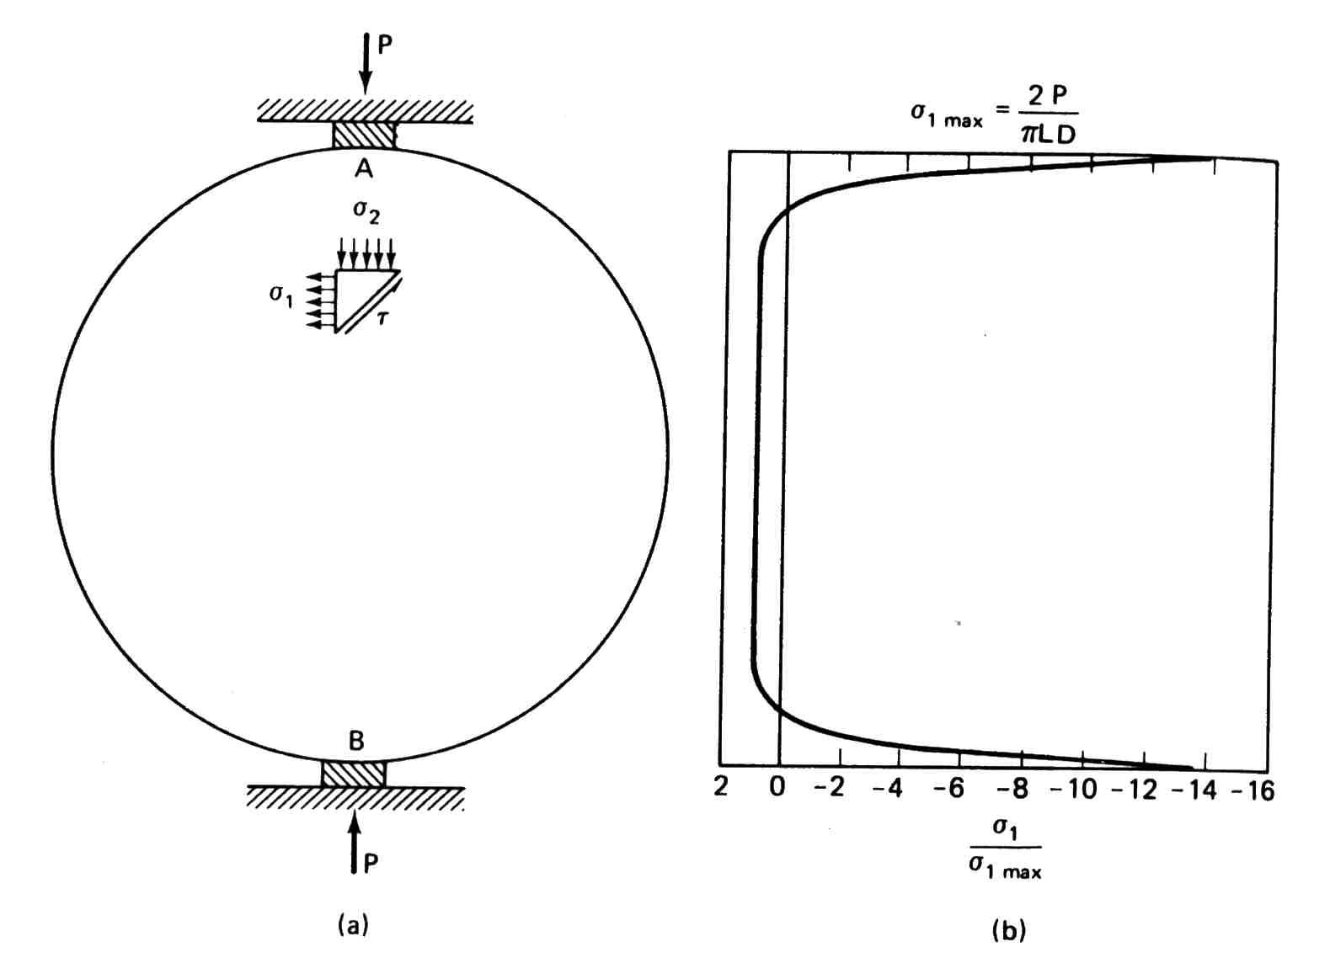
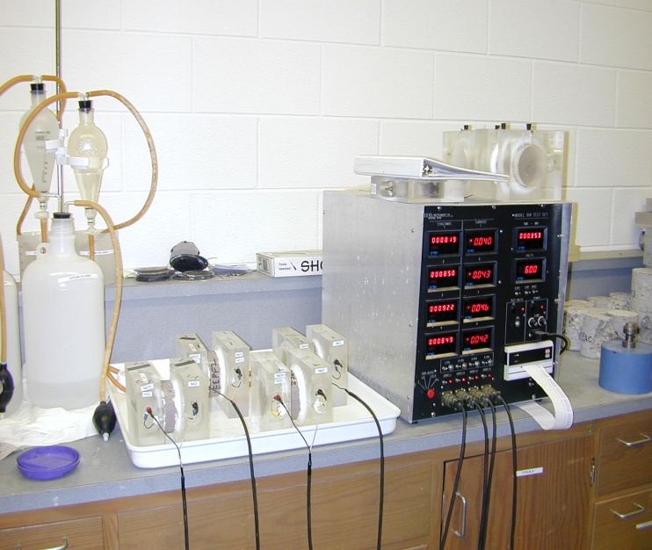
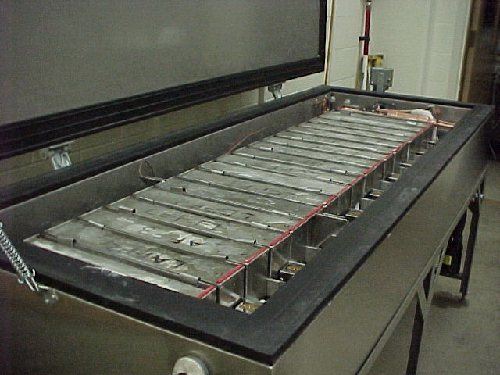
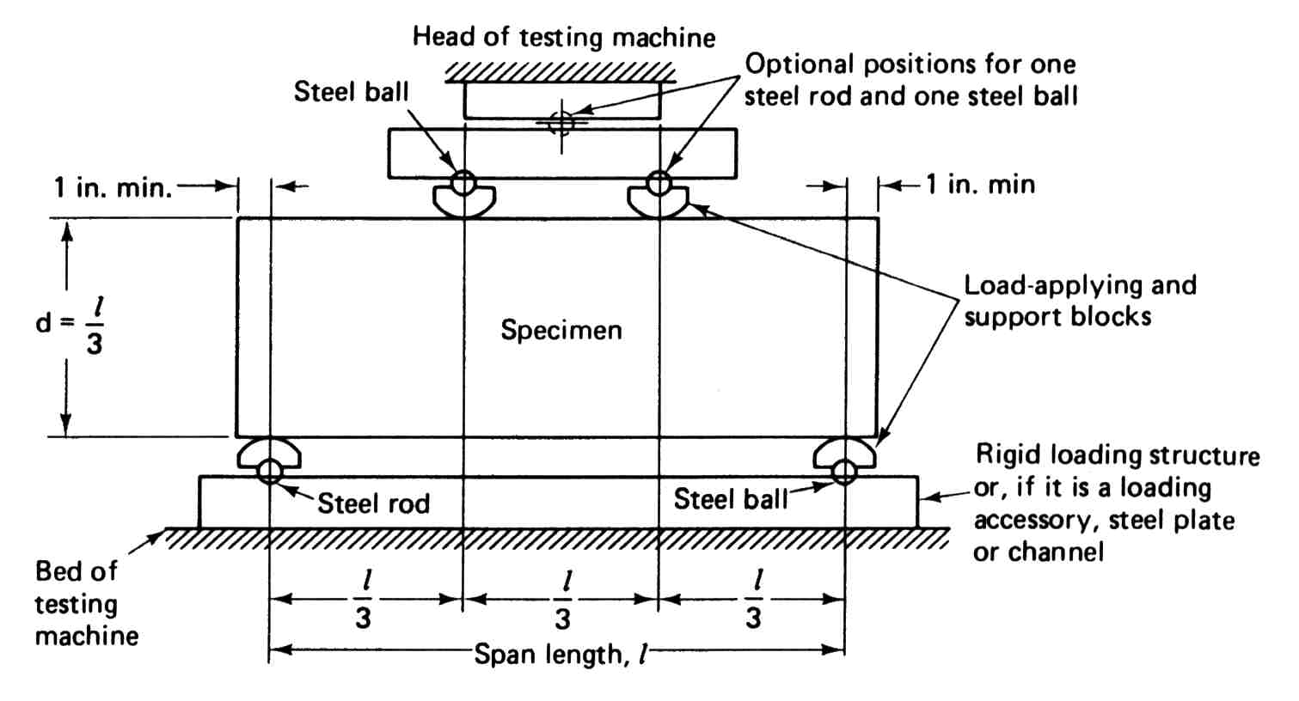
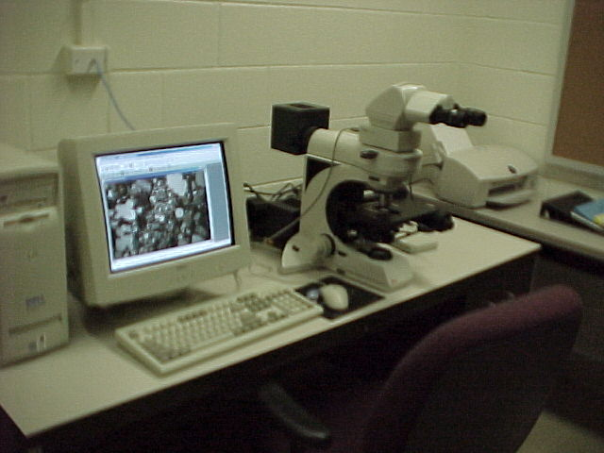
Tests on Hardened Concrete
Split (Indirect)
Tensile Strength
Chloride Permeability
Compressive
Strength
Freeze-Thaw
Resistance
Flexural
Strength
Petrography

Slide 32
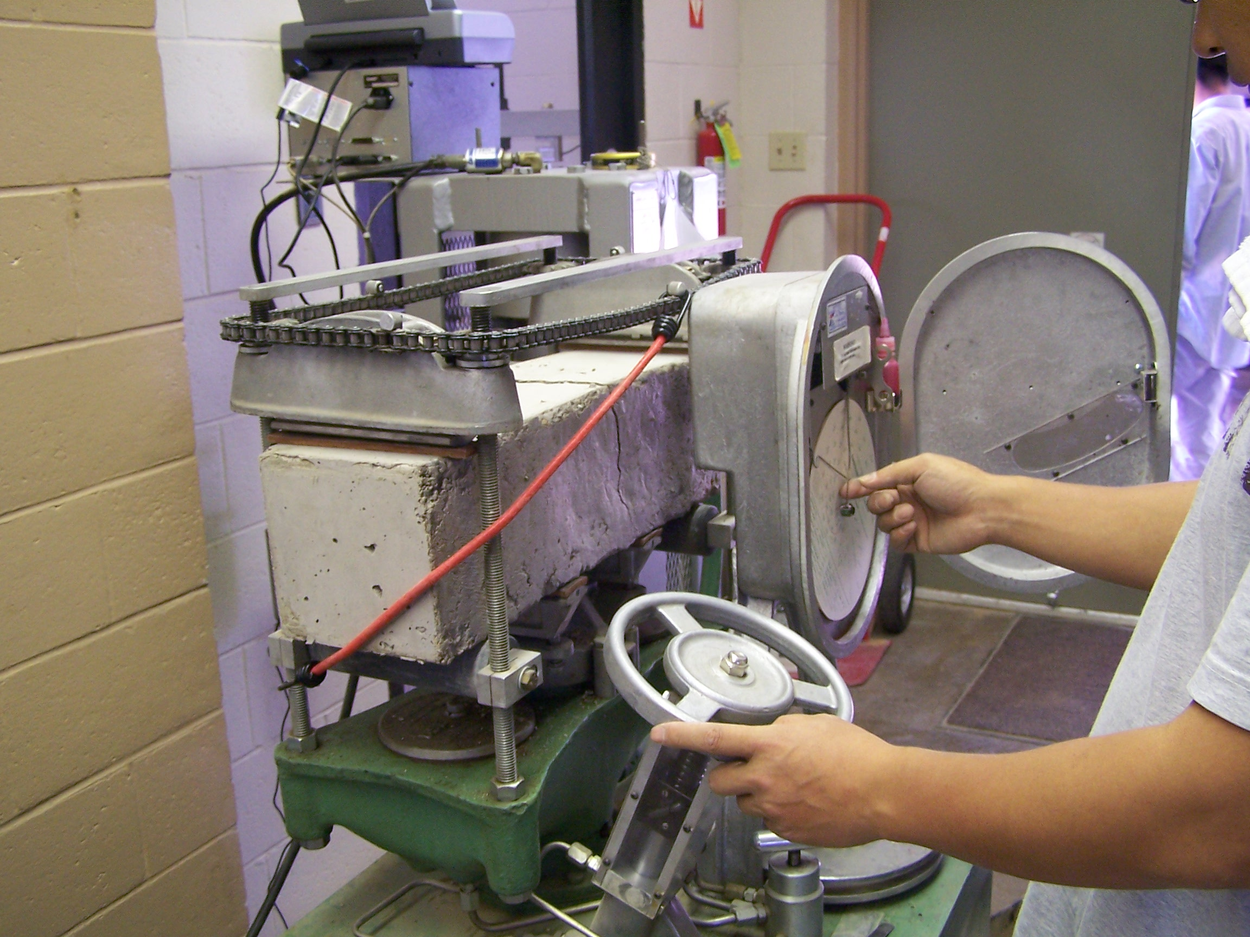

Slide 33
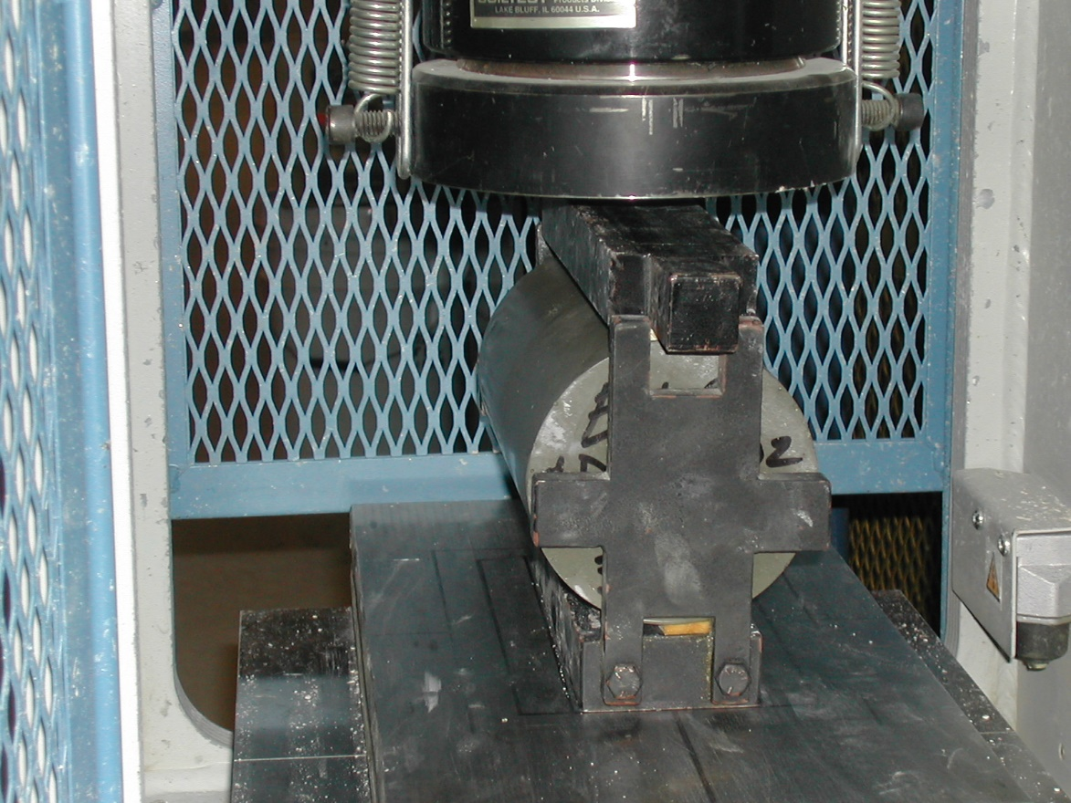
Indirect Tensile Strength

Slide 34
Asphalt
Asphalt Cement Binder
Asphalt Concete

Slide 35
Superpave® Binder Classification

Slide 36
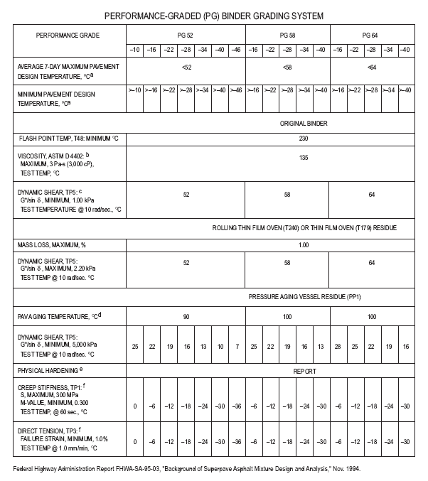
Superpave® Asphalt Binder PG Grading System

Slide 37
Superpave® Binder Classification Calculated Pavement Temp. in Topeka, KS

Slide 38
Superpave® Binder Classification PG Binder Grades for Topeka, KS

Slide 39
Asphalt Concrete: A 3-phase system (aggregate, asphalt cement, air)
V_{AV}
Air Voids
V_{EA}
Effective(free) Asphalt
M_{EA}
M_{TA}
Absorbed Asphalt
M_{AA}
V_{T}
M_{T}
V_{AGG}
Aggregate Solids
M_{AGG}

Slide 40
Asphalt Concrete Volumetrics: Formulas
V_{T} = V_{AGG} + V_{EA} + V_{AV;} M_{T} = M_{AGG} + M_{TA} = M_{AGG} + M_{EA} + M_{AA}
Specific Gravity of Aggregate = G_{S}; Density of water = ρ_{W} = 1000 kg/m³
Bulk Density of Compacted Mix ρ_{MB} = M_{T} / V_{T}
Theoretical Maximum (Rice) Density ρ_{MM} = M_{T} / (V_{AGG}+V_{EA})
Bulk Specific Gravity of Compacted Mix G_{MB} = ρ_{MB} / ρ_{W}
Theoretical Maximum (Rice) Specific Gravity of the Mix G_{MM} = ρ_{MM} / ρ_{W}
Total Asphalt Content in Mix = (M_{TA}/M_{T}) * 100
Bulk Volume of Aggregate = Mass of Aggregate/Density = M_{AGG}/(G_{S} * ρ_{W})
Percent Air Voids (also known as Voids in Total Mix or VTM) = (V_{AV}/V_{T}) *100
%Voids in Mineral Aggregate (VMA) = (Vol. of voids in mix incl. asphalt/V_{T})*100
= (V_{AV}+V_{EA})/V_{T} * 100
%Voids Filled with Asphalt (VFA) = V_{EA}/(V_{AV}+V_{EA}) *100

Slide 41
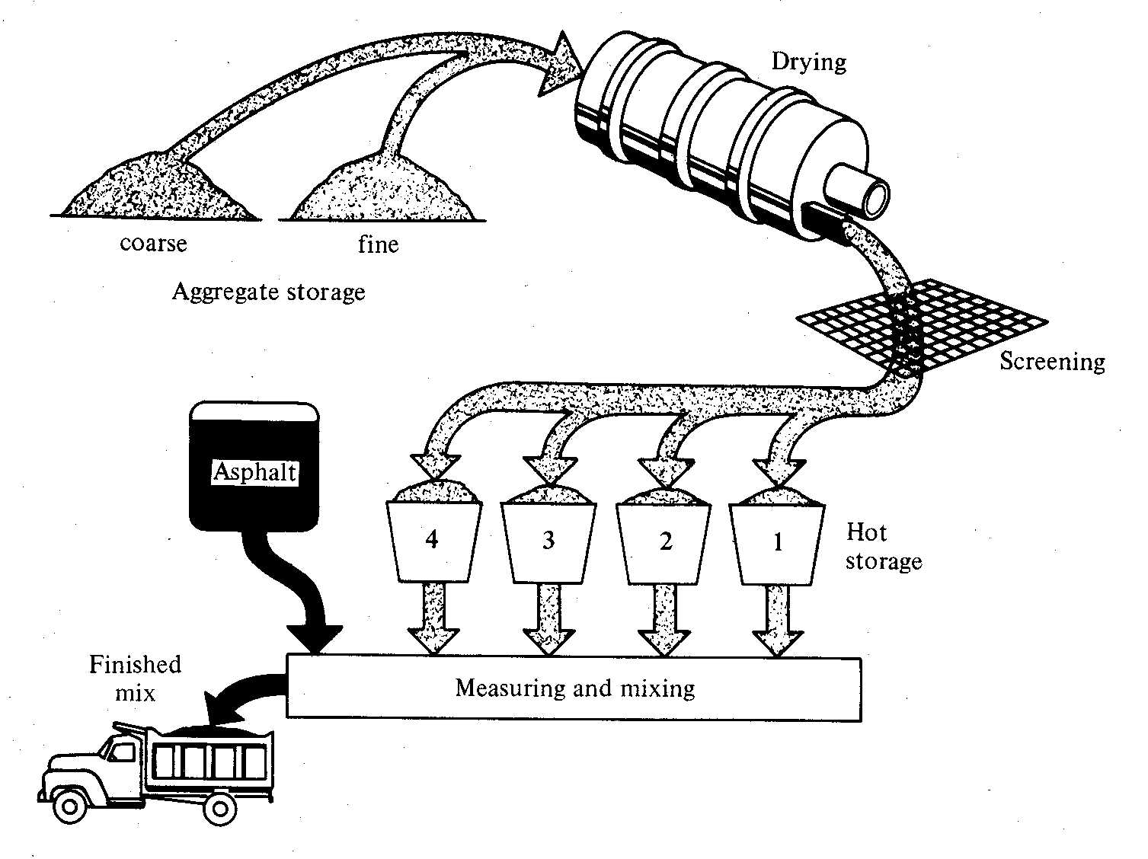
Schematic of a Hot Mix Asphalt Plant

Slide 42
Asphalt Concrete Mix Design
Mix design to achieve maximum stability
Aggregate type & gradation
Asphalt content (% by weight of total mix)
% Air voids
Mix design methods
Marshall Method
Hveem Method
Superpave Method

Slide 43
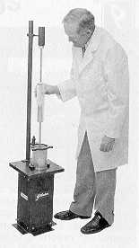
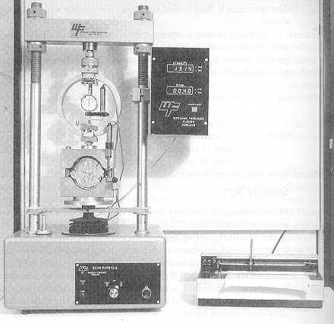
Marshall Mix Design Method

Slide 44
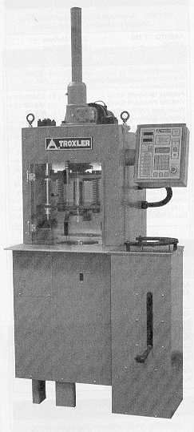
SHRP (Superpave®) Gyratory Compactor

Slide 45
Superpave® Asphalt Concrete Mix Design Criteria

Slide 46
Superpave® Gyratory Compactor Compaction Curve

Slide 47
Metals

Slide 48
Mechanical Properties of Metals
Stiffness - Elastic Modulus or Young’s Modulus (MPa)
Strength - Yield, Ultimate, Fracture, Proof, Offset Yield. Measured as stress (MPa)
Ductility - Measure of ability to deform plastically without fracture - Elongation, Area Reduction, Fracture Strain - (no units or mm/mm)
Toughness, Resilience - Measure of ability to absorb energy (J/m³).
Hardness - Resistance to indentation/abrasion (Various scales, e.g.; Rockwell, Brinell, Vickers.)

Slide 49
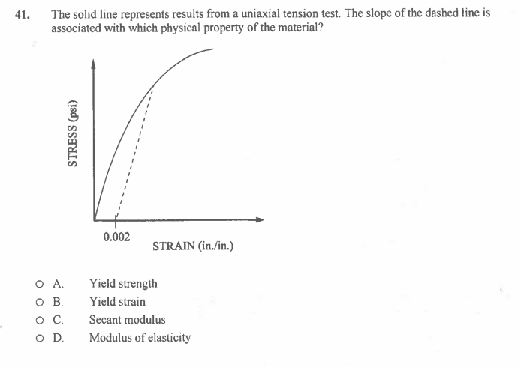

Slide 50
ASTM Tension Test Specimen
2” Gauge Length
L_{o}

Slide 51
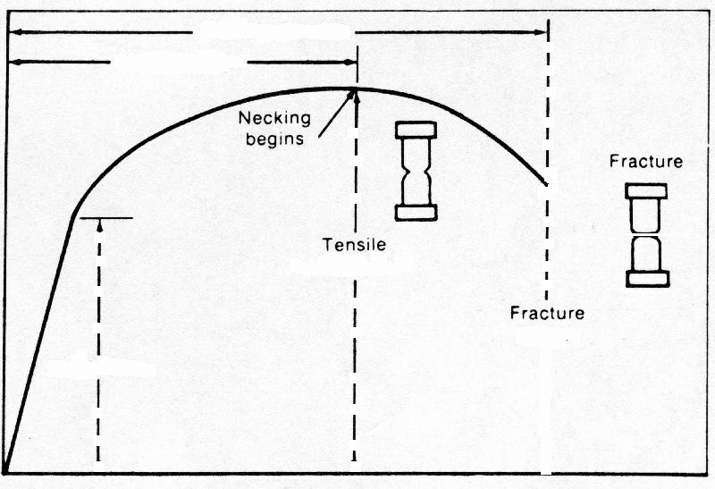
Raw Data Obtained
Total Elongation
Uniform Deformation
Load, P (kN)
X
Maximum Load, P_{max}
Elastic
Deformation
Fracture Load, P_{f}
Elongation, ΔL (mm)

Slide 52
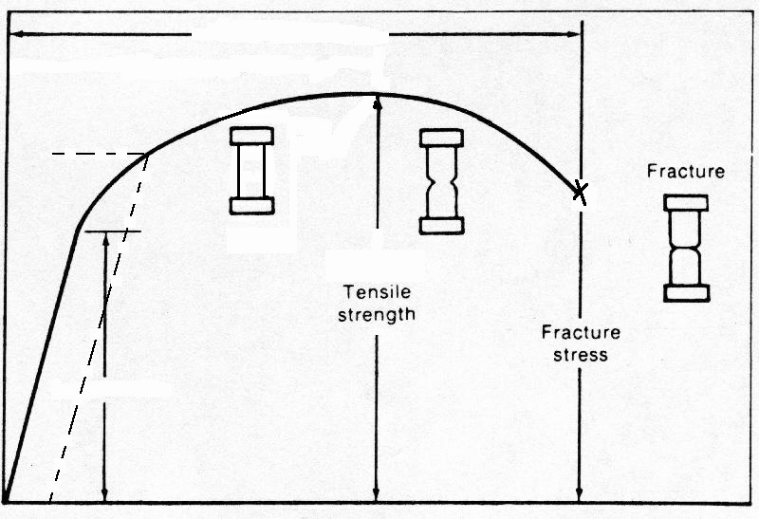
Engineering Stress-Strain Curve
Elongation
S_{y}
0.2% offset
yield stress
Engineering Stress, S=P/Ao
E
(Ultimate)
S_{u}
E
Proportional Limit
Engineering Strain, e = ΔL/Lo

Slide 53
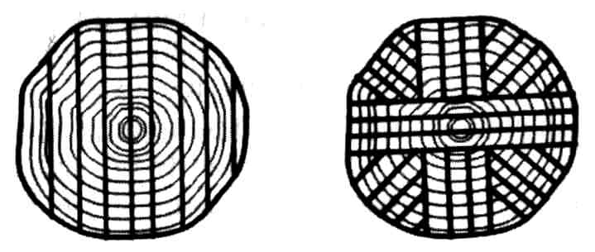
Properties of Wood
Physical Properties
Specific Gravity ~ 1.3 to 1.5
Dry density ~ 20-45 lb/ft³ (300-700 kg/m³)
Mechanical Properties (Extremely anisotropic)
Young’s Modulus - 1-2 x 10⁶ psi (compression parallel to grain)
Strength varies widely because of anisotropy, moisture content, defects, etc.
Tensile strength > compressive strength
Tensile strength parallel to grain ~20x greater than perpendicular
10x greater damping than structural metals

Slide 54
The End

